Slide 1
Overview of Common Referee Injuries
Presented by:
Steve Messineo, PT, DPT
Owner and Executive Director of AAPT and AAFA

Slide 2
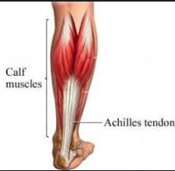
Achilles tendonitis
Tendonitis
Mechanism of Injury
overuse & repetitive microtrauma
Poor foot mechanics (pronation) and ill-fitting shoes
SIGNS & SYMPTOMS
Localized pain toward the heel
Swelling
Often nodule formation
Thickening of tendon due to scar tissue
Treatment:
Rest, massage, stretching (PT) – do not push through the pain! → rupture
PREVENTION: Footwear, Proper Warm-Up, and Calf Strengthening
http://www.podiatryplus.net/achilles-tendon-rupture/

Slide 3
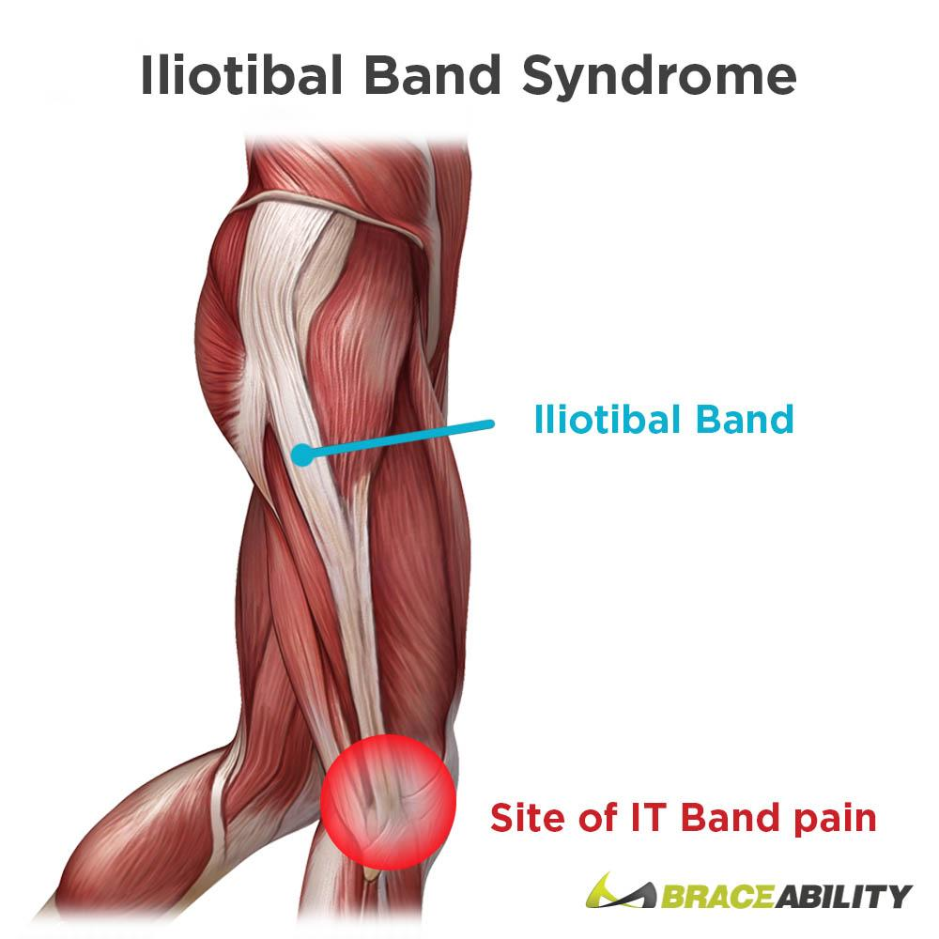
ITB Syndrome
ITB= Iliotibial Band
Tendon of the Gluteal and “TFL” Muscles
Not a significant amount of blood flow
Tendonitis
Mechanism of Injury
Overuse
Weak hip muscles = tension on ITB to transmit force
Muscle Imbalance
Repetitive microtrauma
SIGNS & SYMPTOMS
Localized pain in the insertion (knee)
Lateral thigh, hip pain with running, stairs
Treatment
Self-massage, strengthening the hip muscles (PT)
PREVENTION: Hip Strengthening, especially in lateral motions
https://www.braceability.com/blogs/info/it-band-syndrome

Slide 4
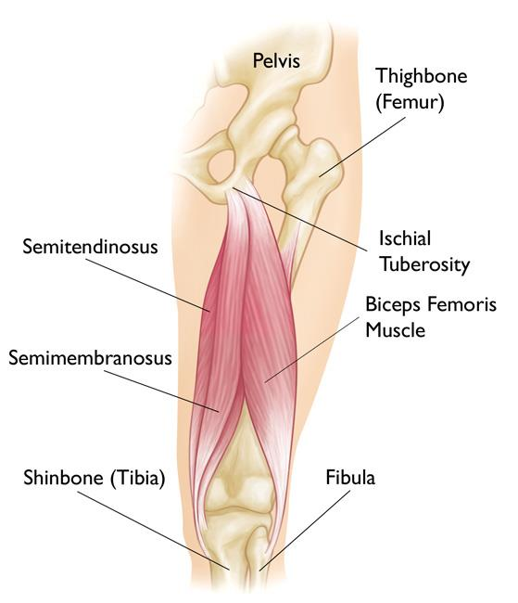
Hamstring Strains
Mechanism of Injury
Sudden change of position
Insufficient muscle length & strength
SIGNS & SYMPTOMS
Localized pain (upper, lower, or middle), inability to bear weight
Swelling
Bruising
Tightness
Treatment:
Gentle ROM and self massage, eventually strengthening of hamstring and gluts (PT)
PREVENTION: flexibility, proper warm up, strengthening for direction changes and stopping/starting
https://orthoinfo.aaos.org/en/diseases--conditions/hamstring-muscle-injuries

Slide 5
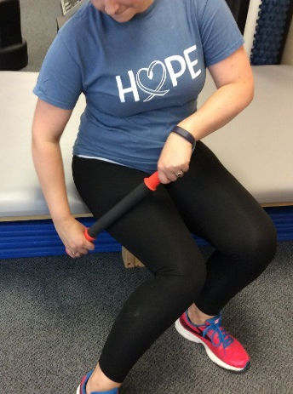
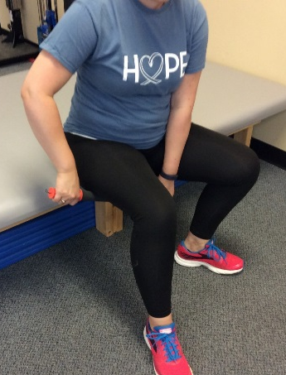
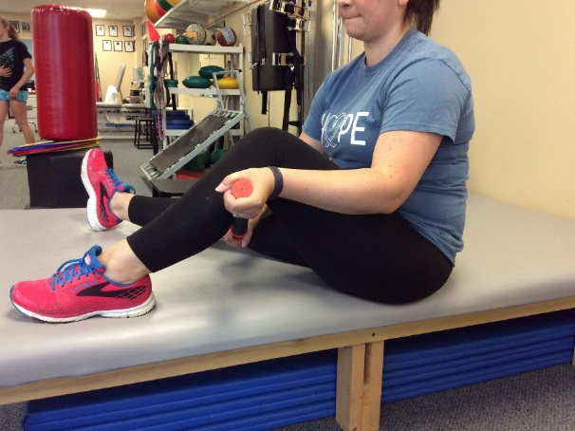
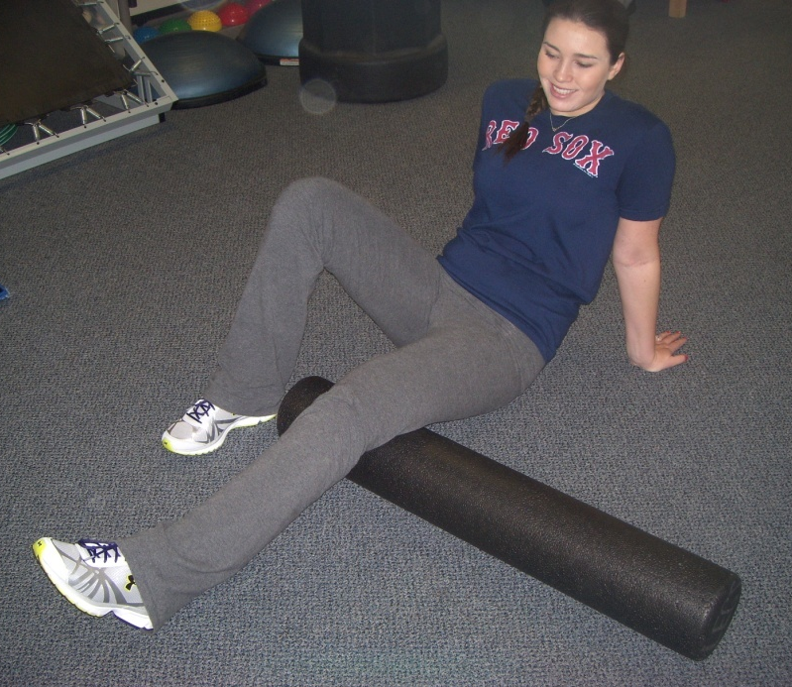
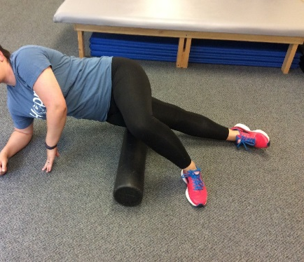
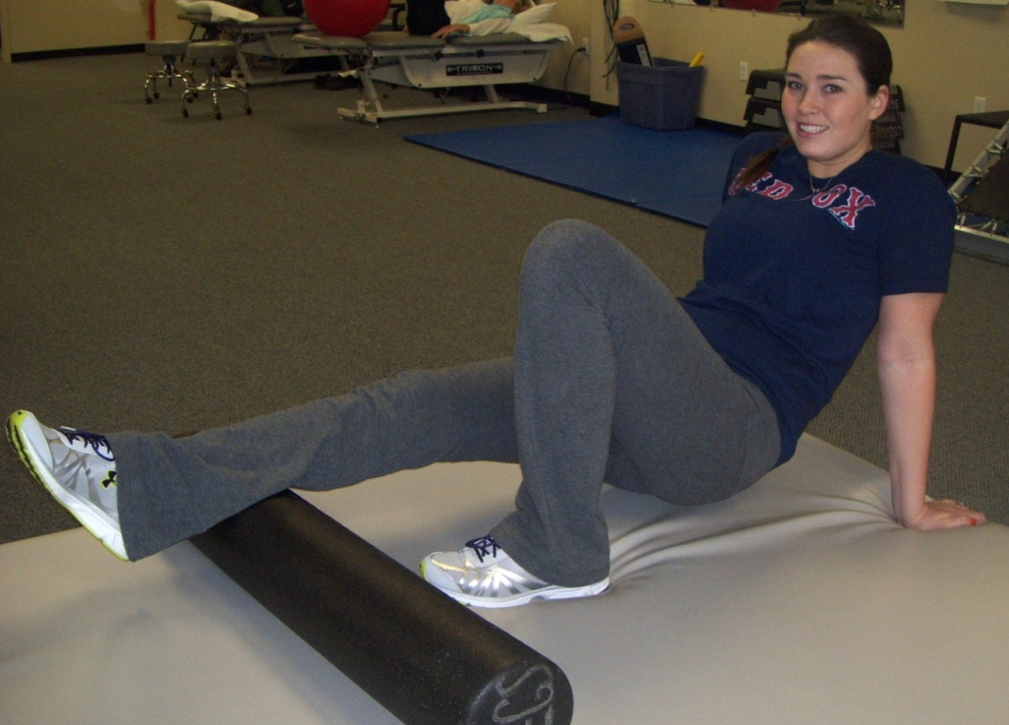
Self-Massage techniques (1-2 MIN EACH AREA, PRIOR TO FIELD)
Tigertail –easy to use at the field
Calves
Hamstrings
IT Band
Foam roller – more aggressive massage
Hamstring
IT Band
Calves

Slide 6
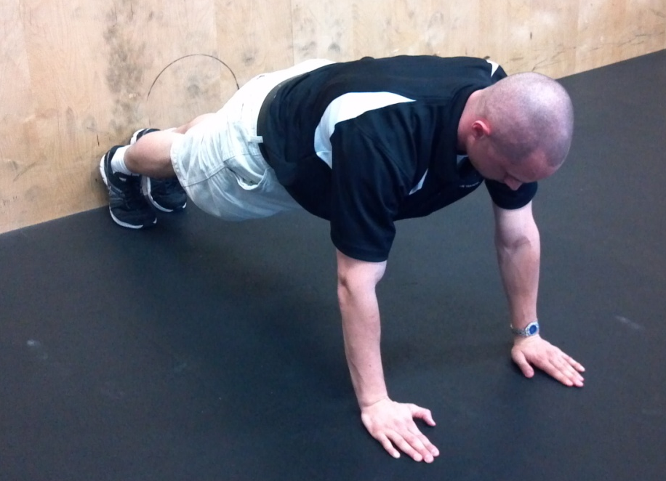
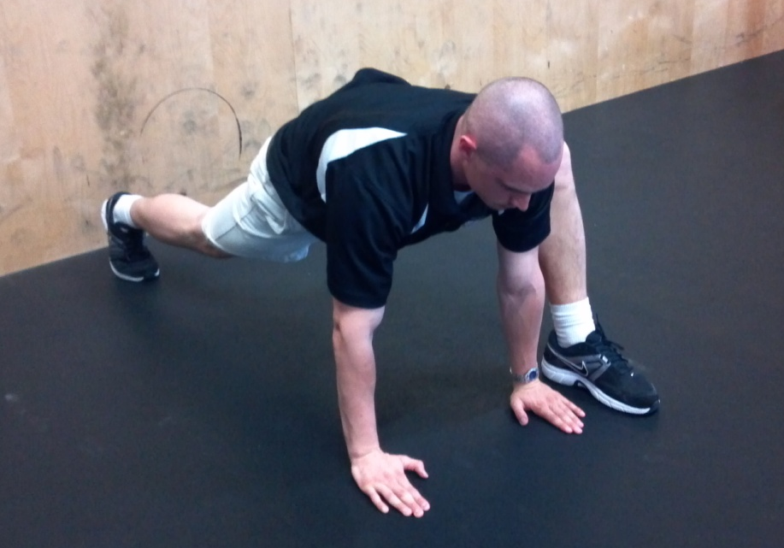
Warm ups (5 SEC HOLD X 10 REPS EACH SIDE, PRIOR TO FIELD)
Inchworms
Spidermans
Leg Cradles

Slide 7
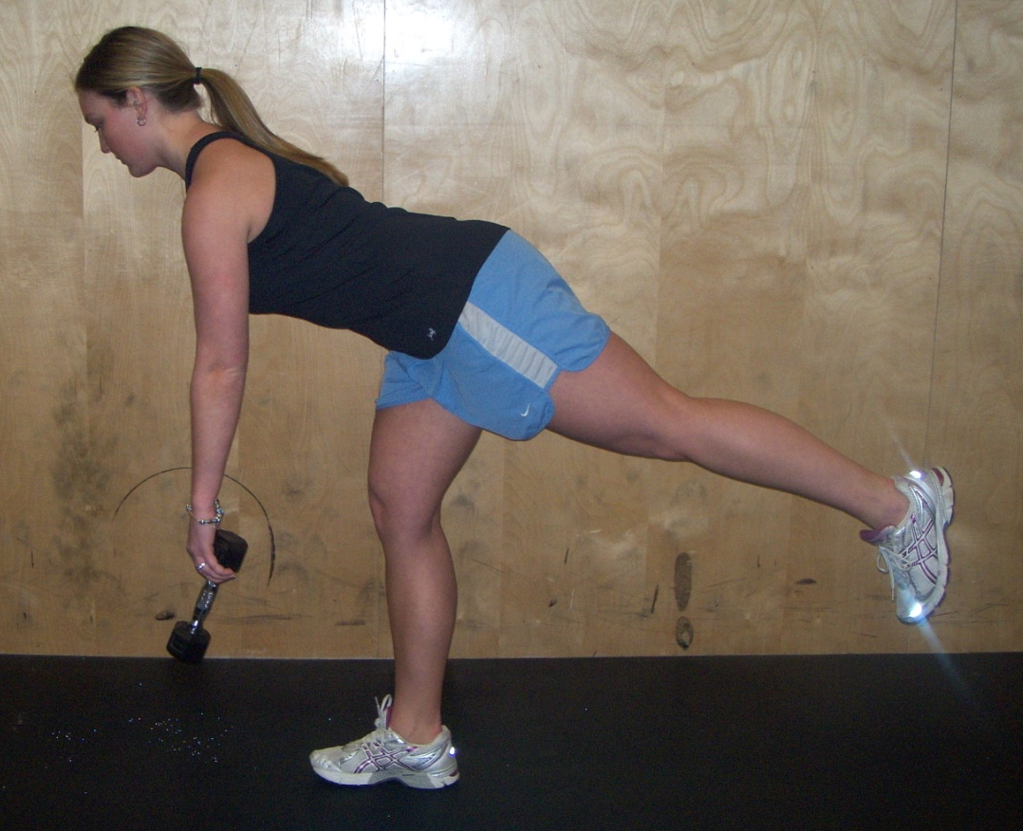
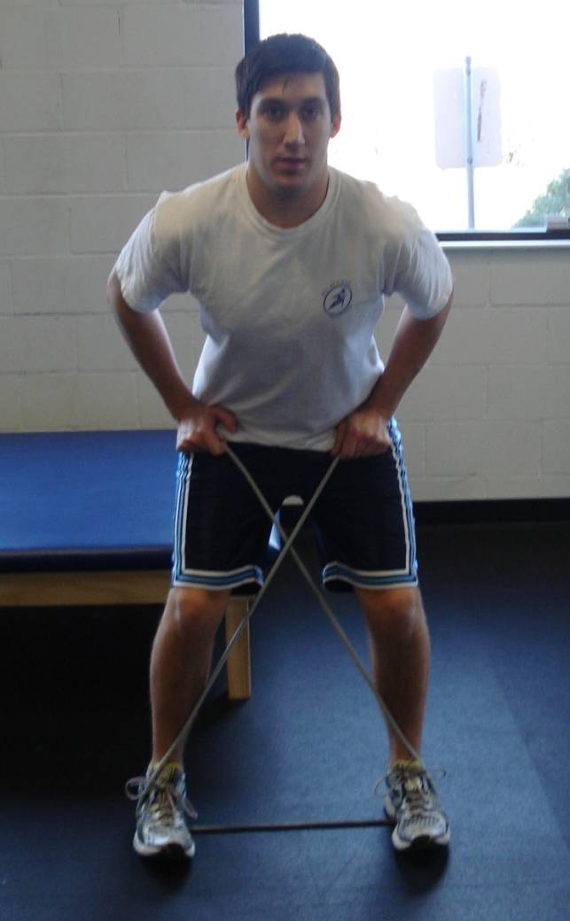
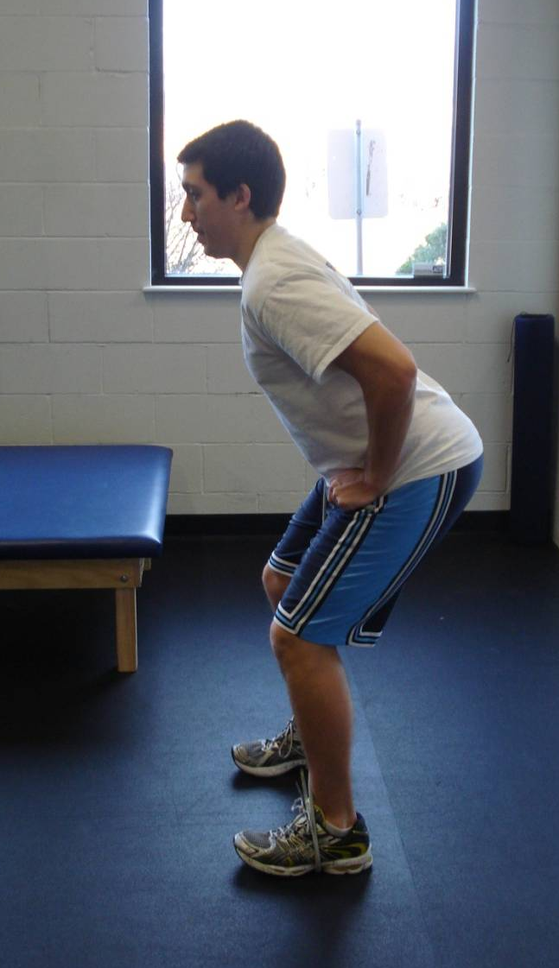
Strengthening exercises (2 X 15 REPS EACH, 2-3 X PER WEEK)
Lateral Lunges
Single leg deadlifts
X-Band (lateral band walks)

Slide 8
Thank you!
Please come see us with any questions!
If you would like a Free PT Exam, give us a call at one of our clinics below:
904C Boston Turnpike Road, Shrewsbury | 508-845-3500
50 Leominster Road, Sterling | 978-422-0431

