Slide 1
Dual System of Control
Rich Valle
EMSOA Rule Interpreter

Slide 2
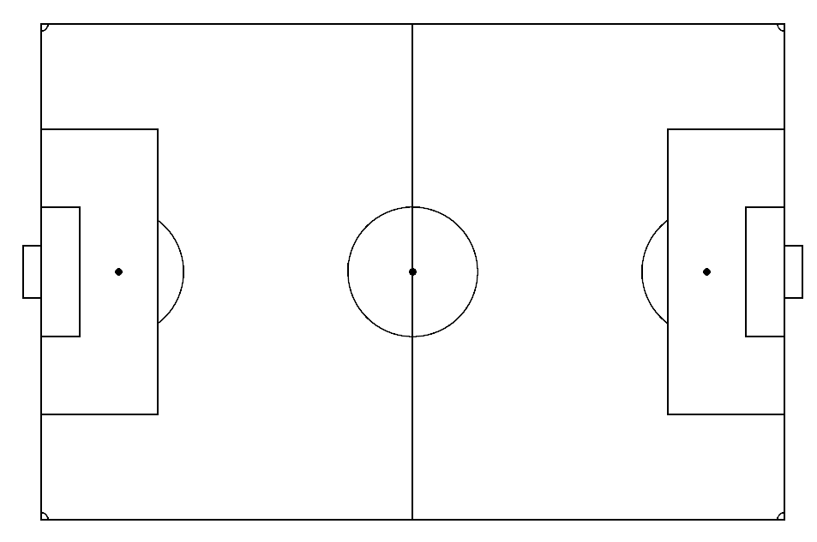
Dual System of Control – Kick Off
Imaginary Diagonal Line separating areas of each official’s responsibility
Bench
Bench
T
Offense Team
Defense Team
x
x x
x
G x x
x
x x
x
o
o
o
o
o o G
o
o
o
o
Lead Official
Trail Official
L

Slide 3
Dual System of Control – Kick Off
Trail Official
Bench
Bench
Lead Official
Make sure proper number of x players are on the field
T
Make sure proper number of o players are on the field
x
x x
x
G x x
x
x x
x
o
o
o
o
o o G
o
o
o
o
Responsible for x Goalie Alert
Responsible for o Goalie Alert
Keep official time (Bench Side)
Backup time Keeper
Signal T when all is ready on defense side
Blow whistle to start play
Observer proper kick-off
Be in position to rule on offside
L

Slide 4
Dual System of Control – Ball In Play
Trail Official
Lead Official
Get as far up the line as you can and still be able to get back to see offside
Bench
Bench
T
x
o
x o
x
o
x
x o o G
o
x
x o
x o x
o
x o
The L official needs your help in the circled area
The touchline is yours all the way down
G
Watch for fouls, L may be checking for offside.
Never be on your side of halfway when a shot is taken
L

Slide 5
Dual System of Control – Ball In Play
Trail Official
Lead Official
Deal with offsides and fouls
Bench
Bench
T
x
o
x o
x
o
x
x o o G
o
x
x o
x o x
o
x o
You should be at least even with the forward most attacker if you cannot be even with the 2nd to last defender
G
When attack nears the goal--
Go to Goal. Cut corner. You are the goal judge.
L
L

Slide 6
Dual System of Control – Ball In Play
Trail Official
Lead Official
The Whistle to stop play is the responsibility and Right of both Officials
But
Do not whistle a play from 40-50 yd away when your partner is right on the play.
Bench
Bench
x
o o
x
x o o
x o
x
x o
x o x G
o
x o o
x
T
Defer the call to the closer official unless your are sure partner was unaware of the foul (for example, it happened behind him/her)
G
L

Slide 7
Dual System of Control – Goal Kick
Lead Official
Trail Official
Handle x and o subs, if any
Bench
Bench
Check that ball is properly placed
o x o
o
x
x o
x o
x o
x
x o x G
o
x o o
x
Indicate to T when all is ready
Deal with time wasting if necessary
L
Be in position to see action when ball lands
Signal when all is ready
Be ready to move into position to deal with offside on x side
Be in position to rule that the ball has cleared penalty area
Be in position to see if ball clears penalty area on your side
Be ready to move into position to deal with offside on o side
T

Slide 8
Dual System of Control – Penalty Kick
Trail Official
Lead Official
If necessary, deal with kicker and spotting the ball
Bench
Bench
If necessary, deal with kicker and spotting the ball
o
o x
x x
x o
o
x x
x o
o xo
x
x o
o
o
May sure players are outside penalty area and arc. No player closer to end line than penalty kick mark
T
Give instructions to keeper
Get in position to see goal
G
G
Be ready to retreat up field and deal with touch line.
L
Blow whistle when all is ready
Watch for shot directly off cross bar or upright
Determine if kicker and keeper followed proper procedure

Slide 9
Dual System of Control – Corner Kick I
Trail Official
Lead Official
Be in position to spot fouls
Bench
Bench
Make sure ball is properly in corner
Watch action near keeper. L must watch initial ball flight to see if it stays in bounds
o x
x
x o
o o
x
x o o
o x o G
x
x o
x o
Watch initial flight of ball
T
Focus on action where ball comes down
Be ready to sprint back up field in case of a counter attack
Be ready to move up field or find second-to-last defender and deal with offsides
G
L
Deal with possible subs (o only if x subs)
Signal start of play – if necessary
Indicate to L when all is ready
x

Slide 10
Dual System of Control – Corner Kick II
Trail Official
Lead Official
Same as Corner Kick I except
Bench
Bench
L will not need as much assistance from T because all of the play is in L’s sights (Flight of the ball and action near keeper)
o
x x
x o
o o
x
x o o
o x o G
x
x o
x o
This may be a better position to deal with subs
Signal start of play – if necessary
L
Indicate to L when all is ready
G
T
x

Slide 11
Dual System of Control – Throw- In I
Trail Official
Lead Official
Bench
o
Bench
Be in position to see throw-in and area it is going to
Be in position to see offsides and fouls
T
o o x
x o x
x o
x o x o x
x o
x
x
o o
Deal with any substitutions
G
G
Be read for counter attack
L
NOTE: Both officials must keep non-whistle hand and arm in the “Stop” position until the “Ball side” official indicates and signals for the throw-in.

Slide 12
Dual System of Control – Throw- In II
Trail Official
Lead Official
Similar to Throw-In I, But…
Bench
Bench
Responsible for substitutions
L should “cheat” in to where ball is coming as long as L can still see that the thrower’s feet are where they should be
If there are substitutions, point to “Ball side” official to signal ready for throw-in
T
G
o
x o x
x o
x o x
x
o x o x
o x x
o o
Signal for throw-in only after getting signal from “Bench side” official when there are substitutions
G
“Cheat” into the field as there are no players near T‘s touch line
L
L
o

Slide 13
Dual System of Control – Free Kick
Trail Official
Lead Official
Bench
Bench
Spot the ball at the point of the foul. If the spot is on the far side, simply stand even with the spot. Get the Kicker’s attention and indicate the spot with outstretched arm.
After seeing your partner take control of the spot, deal with the wall (if any). Then go to deal with offside and where the action will be.
T
o o
x o x
x o
x o x o x
x o
x x
x
o o
G
G
If a whistle for the restart is needed, it is L‘s whistle.
L
o
L
L is also the goal judge

Slide 14
Dual System of Control – Drop Ball
Trail Official
Lead Official
Usually the ball is dropped by the official who is closest to the side the ball is to be dropped on.
Bench
Bench
In the situation shown, it is better to have T come into the field for the drop ball.
o
x o
x
x o
x
x o o
o
x
x o
x o x
o
x o
T
With T dropping the ball, L takes a position to see a quickly developing offside
T
T retreats to the touch line as soon as the ball is dropped.
G
G
L

Slide 15
Dual System of Control
Bench
Bench
ENJOY THE GAME

